Slide 1

Introduction to Machine Learning

Slide 2
1
Introduction
ML Workshop
Today’s Agenda
2
Python 101
3
Intro into ML
4
Linear Regression - Theory
5
Linear Regression - Practice

Slide 3
01
Introductions

Slide 4

Bujar Bakiu
Bujar Bakiu
MD & Machine Learning Engineer, Data Max
Graduated 2016, MSc, RWTH Aachen University
Passionate about Machine Learning, Software Engineering and running
Find me in:
LinkedIn: linkedin.com/in/bbakiu Email: bujar@data-max.io

Slide 5

Evis Plaku
Evis Plaku
Software Engineer, Holberton School
Graduated 2013, MSc, Freiburg University
Passionate about Teaching, Technology and intelligent systems
Find me in:
LinkedIn: Evis Plaku Email: evis.plaku@holbertonschool.com

Slide 6
02
Python 101

Slide 7
03
Intro into ML

Slide 8

ML WORKSHOP
What is Machine Learning
Goal
Machines that learn to perform a task from experience
Why?
Task cannot be well defined
Volume of data is just too big to analyze
Environment changes
New knowledge become available

Slide 9

ML WOrkshop
Learning
Machines that learn to perform a task from experience
Learning to perform a task from experience
We don’t want to encode knowledge
Machine should discover and learn automatically from past
Statistics, Probability Theory, Decision Theory, Information Theory, Optimization Theory

Slide 10

ML WOrkshop
Task
Machines that learn to perform a task from experience
Usually, a function
y = f(x, w)
X: input aka. features
W: parameters aka. weight
y: output aka, target (label)
Classification vs. Regression vs. Reinforcement Learning

Slide 11

ML WOrkshop
Perform
Machines that learn to perform a task from experience
“99% correct classification”
- Of what?
- What was the training data set? What about testing?
- Is it matching real world?
Performance Measurement:
- Numbers
- One or more metrics
- Different for classification vs. regression

Slide 12

ML WOrkshop
Experience
Machines that learn to perform a task from experience
When labelled data available: - Supervised Learning
No labelled data:
- Unsupervised learning
Some labelled data:
- Semi-supervised learning
Feedback/rewards:
- Reinforcement Learning

Slide 13

ML WOrkshop
Basic Algorithms
Linear Regression
Naïve Bayes
Logistic Regression
K-Nearest Neighbours
SVM
K-Means Clustering
Decision Tree / Random Forest
DBSCAN Clustering

Slide 14
04
Linear Regression

Slide 15
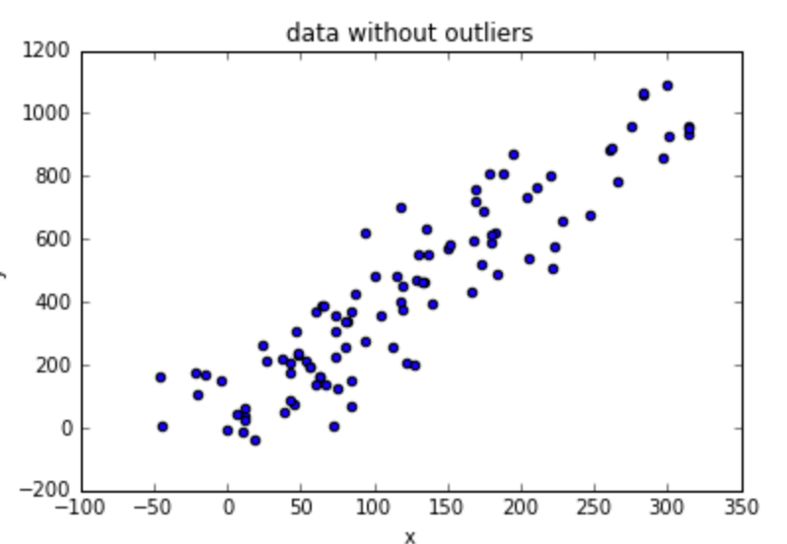
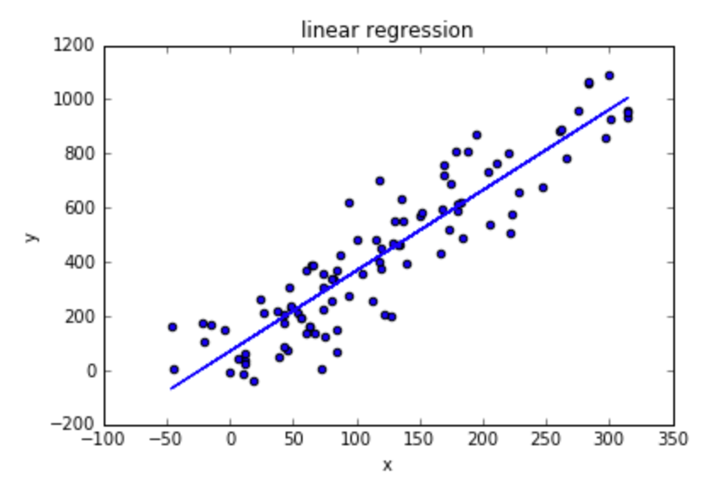
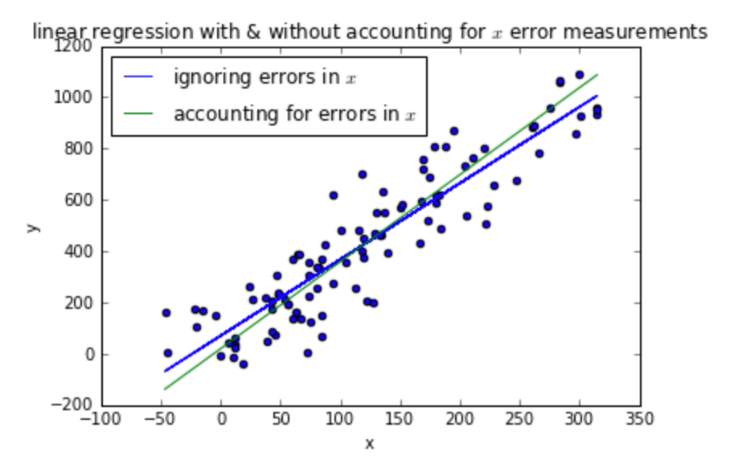
ML WOrkshop
Linear Regression
Relationship between target and features
Which line best fits the data?

Slide 16
ML WOrkshop
Linear Regression
y = wx + w₀
y -> target
x -> feature
w -> weight
y = f(x₁, x₂, x₃, x₄ ,…, x_{n})
y_{k} = w₁x_{1k} +w₂x_{2k} + w₃x_{3k} + w₄x_{4k} +…+ w_{n}x_{nk} + w₀

Slide 17
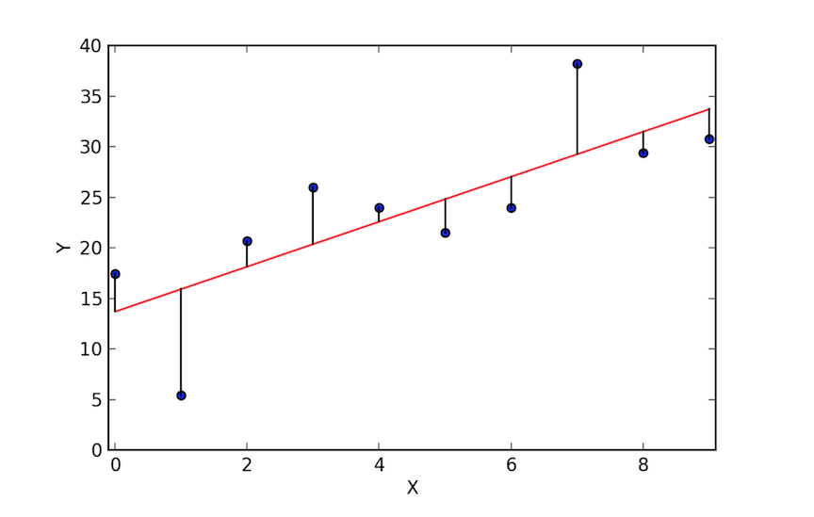
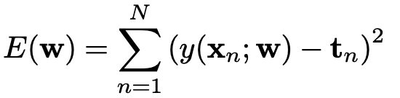
ML WOrkshop
Linear Regression
Goal: Reduce residuals (loss)
Least square method
Try to minimize the sum-of-squares error
LS

Slide 18
05
Hands-On Time 🎉

Slide 19
Feedback

Slide 20
THANK YOU!
www.data-max.io
bujar@data-max.io

